Slide 1
Database mini project phase - 0
Car Rental Management System
Karthik B.N : 1RN18CS050
Akhilesha A Saralaya : 1RN18CS011
R N S INSTITUTE OF TECHNOLOGY- BENGALURU

Slide 2
OUTLINE
Introduction – relevance of the topic
Mini-world- problem statement
Schema
ER diagram
Technologies used

Slide 3
Introduction- relevance of the topic
Car rental or car hire agencies are private companies that provide short time leasing vehicles for a specified time with a fee to their customers. All over the world, car rental service increasingly becomes the preferred option for most people, especially among students in campuses and universities. This occurs because not all students can afford having their own vehicle and perhaps the university bus service doesn’t always help. Besides, the raising taxi fares and inconsistent bus arrivals continue to discourage people from taking up the public transport. Therefore, car rental service continues to grow everywhere, hence it required an improvement and good monitoring system.

Slide 4
Manual renting services based on manual work includes a lot of time and the resources required is also increased because each process requires different resources. Besides, the user will have to go manually at the center or must first contact the car rental company for the desire vehicle. Therefore, the online car rental system will provide and support the customer for the reservation, assist management in knowing rental car inventory at a specified time and notify the customers about the availability of the car reserved, which support the satisfactory service to customer and support the company’s operational processes.

Slide 5
Mini-world- problem statement
Car Rental Management System deals with:
Helping the customer who wants to rent a car by using online interface.
Taking the input regarding the type of car wanted, and for how many number of days they want to rent the car.
Showcasing of the bill to the customer after the payment is done.

Slide 6
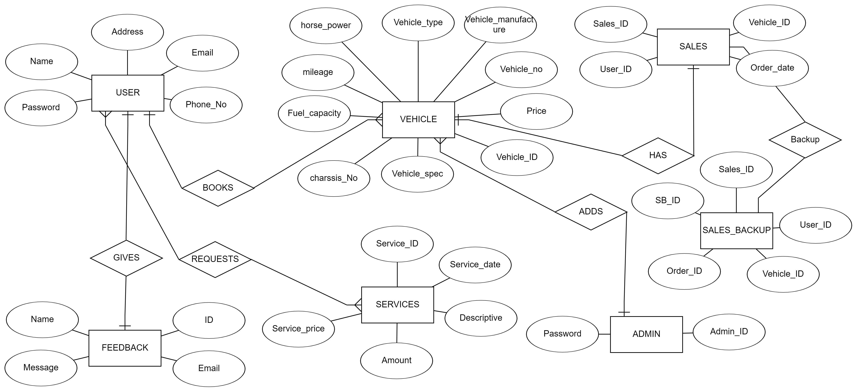
ER Diagram

Slide 7
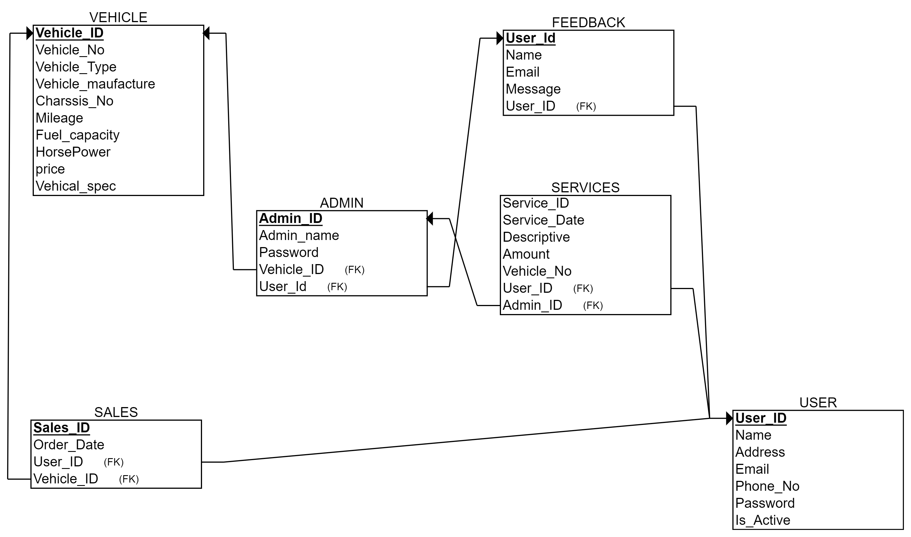
Schema

Slide 8
Tools and technologies used
Operating System : Windows 10
ER diagram & Schema making software: ERDplus : https://erdplus.com/
Front-End : HTML, CSS, Bootstrap, JavaScript
Back-End : PHP,SQL, XAMPP

Slide 9
Thank you
SUGGESTIONS

